Slide 1
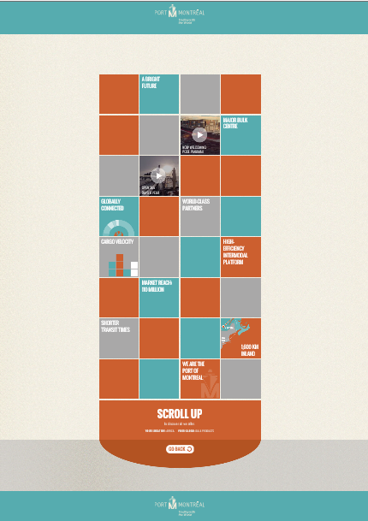
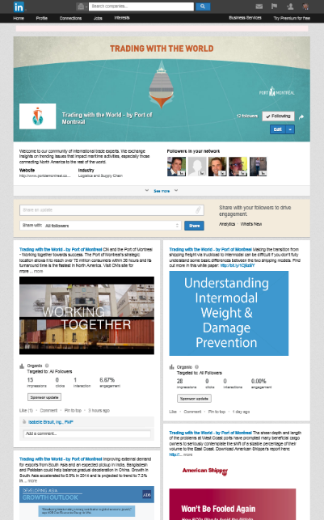
Port of Montreal
Trading with
the World
Overall Campaign
Use this area for logo
(delete text box b
B2B WEB PLATFORM
LINKEDIN SHOWCASE PAGE

